Slide 1






Slide 2

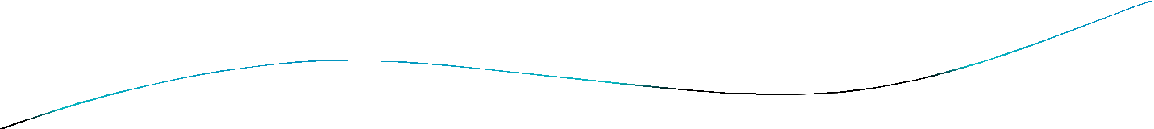
What is random forests
An ensemble classifier using many decision tree models.
Can be used for classification or Regression.
Accuracy and variable importance information is provided with the results.

Slide 3

The Algorithm
 Let the number of training
variables in the classifier be M.
cases be N, and the number of
The number m of input variables are used to determine the decision at a node of the tree; m should be much less than M.
Choose a training set for this tree by choosing N times with replacement from all N available training cases. Use the rest of the cases to estimate the error of the tree, by predicting their classes.
For each node of the tree, randomly choose m variables on which to base the decision at that node. Calculate the best split based on these m variables in the training set.
Each tree is fully grown and not pruned.

Slide 4

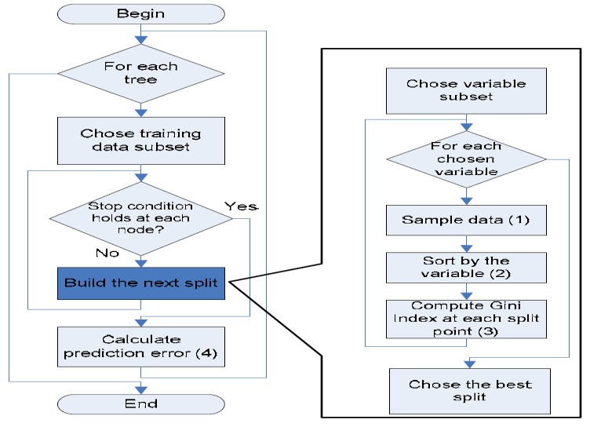
Random forest algorithm(flow chart):

Slide 5

Advantages
It produces a highly accurate classifier and learning is fast
It runs efficiently on large data bases.
It can handle thousands of input variables without variable deletion.
It computes proximities between pairs of cases that can be used in clustering, locating outliers or (by scaling) give interesting views of the data.
It offers an experimental method for detecting
variable interactions.

Slide 6

 A Random Forest is a classifier
consisting of a
collection of tree-structured classifiers {h(x, Θk ), k = 1....}where the Θk are independently, identically distributed random trees and each tree casts a unit
vote for the final classification
of input x. Like
CART, Random Forest uses the gini
index for
determining the final class in each tree.
 The final class of each tree is aggregated and voted by weighted values to construct the final classifier.

Slide 7


Gini Index
 Random Forest uses the gini index taken from the CART learning system to construct decision trees. The gini index of node impurity is the measure most commonly chosen for classification-type problems. If a dataset T contains examples from n classes,
gini index, Gini(T) is defined as:
where pj is the relative frequency of class j in T.

Slide 8


 If a dataset T is split into two subsets T1 and T2 with sizes N1 and N2 respectively, the gini index of the split data contains examples from n classes, the gini index
(T) is defined as:
**The attribute value that provides the smallest SPLIT Gini (T) is chosen to split the node.

Slide 9

Operation of Random Forest
 The working of random forest algorithm is as follows.
A random seed is chosen which pulls out at random a collection of samples from the training dataset while maintaining the class distribution.
With this selected data set, a random set of attributes from the original data set is chosen based on user defined values. All the input variables are not considered because of enormous computation and high chances of over fitting.

Slide 10

In a dataset where M is the total number of input attributes in the dataset, only R attributes are chosen at random for each tree where R< M.
The attributes from this set creates the best possible split using the gini index to develop a decision tree model. The process repeats for each of the branches until the termination condition stating that leaves are the nodes that are too small to split.

Slide 11

Example:
The example below shows the construction of a single tree using the abridged dataset .
Only two of the original four attributes are chosen for this tree construction.
RECORD | ATTRIBUTES |  | CLASS
 | HOME_TYPE | SALARY
1 | 31 | 3 | 1
2 | 30 | 1 | 0
3 | 6 | 2 | 0
4 | 15 | 4 | 1
5 | 10 | 4 | 0

Slide 12

Assume that the first attribute to be split is HOME_TYPE attribute.
The possible splits for HOME_TYPE attribute in the left
node range from 6 <= x < 31, where x is the split value.
All the other values at each split form the right child node. The possible splits for the HOME_TYPE attributes in the
dataset are HOME_TYPE <=6, HOME_TYPE <=10,
and
HOME_TYPE <= 15, HOME_TYPE <= 30,
HOME_TYPE <= 31.
 Taking the first split, the gini index is calculated as follows:

Slide 13

 Partitions after the Binary Split on HOME_TYPE <=6 by the Random Forest
Attribute | Number of records
 | Zero(0) | One (1) | N = 5
HOME_TYPE <=6 | 1 | 0 | n1 = 1
HOME_TYPE > 6 | 2 | 2 | n2 = 4
 Then Gini(D1) , Gini (D2) , and GiniSPLIT are calculated as follows:

Slide 14

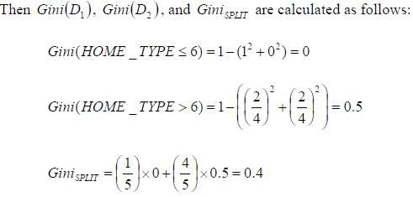

Slide 15

In the next step, the data set at HOME_TYPE <=10 is split
and tabulated in Table.
Partitions after the Binary Split on HOME_TYPE <=10 by the Random Forest:
Attribute | Number of records
 | Zero(0) | One (1) | N = 5
HOME_TYPE <=10 | 2 | 0 | n1 = 2
HOME_TYPE > 10 | 1 | 2 | n2 = 3
 Then Gini (D1) , Gini (D2) , and Gini SPILT are calculated as follows:

Slide 16

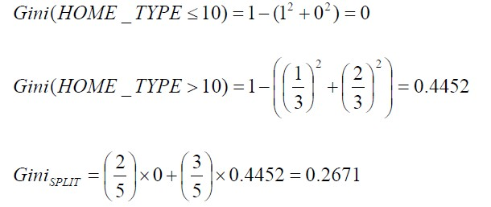

Slide 17

 tabulates the gini index value for the HOME_TYPE attribute at all possible splits.
Gini SPILT | Value
Gini SPILT(HOME_TYPE<=6) | 0.4000
Gini SPILT(HOME_TYPE<=10) | 0.2671
Gini SPILT(HOME_TYPE<=15) | 0.4671
Gini SPILT(HOME_TYPE<=30) | 0.3000
Gini SPILT(HOME_TYPE<=31) | 0.4800
 the split HOME_TYPE <= 10 has the lowest value

Slide 18

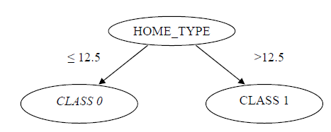
 In Random Forest, the split at which the gini index is lowest is chosen at the split value.
 However, since the values of the
are
HOME_TYPE attribute
continuous in nature, the midpoint of every pair of consecutive values is chosen as the best split point.
 The best split in our example, therefore, is at HOME TYPE
=(10+15)/2=12.5 instead of at HOME
_TYPE<= 10 . The decision tree after
the first split is shown in:

Slide 19

This procedure is repeated for the remaining attributes in the dataset.
In this example, the gini index values of the second attribute SALARY are calculated.
The lowest value of the gini index is chosen as the best split for the attribute.
The final decision trees shown in:

Slide 20

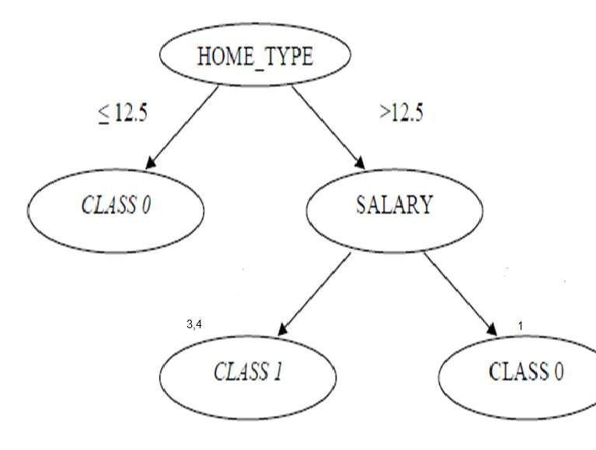

Slide 21

The decision rules for the decision tree illustrated are:
If HOME_TYPE <= 12.5, then Class value is 0.
If HOME_TYPE is > 12.5 and SALARY is 3/4, then Class value is 1.
If HOME_TYPE is > 12.5 and SALARY is 1, then Class value is 0.

Slide 22

 This is a single tree construction using the CART algorithm. Random fores follows this same methodology and constructs multiple trees for the forest using different sets of attributes. Random forest has uses a part of the training set to calculate the model error rate by an inbuilt error estimate, the out- of-bag (OOB) error estimate.

Slide 23

THANK YOU

